Slide 1
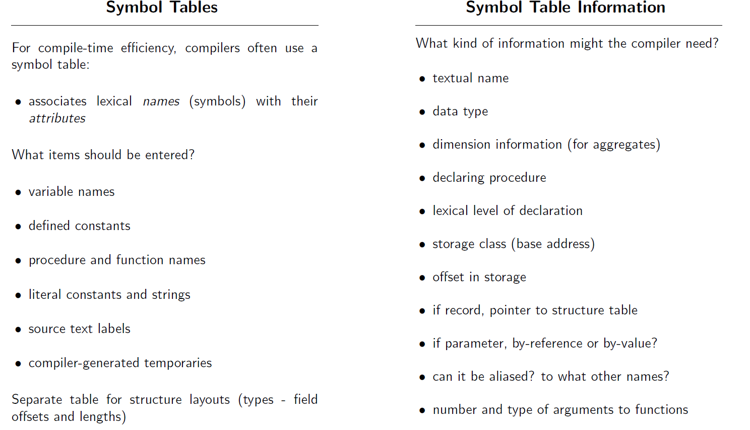
Symbol Tables

Slide 2
Mixed Type Calculator
Symbol Record
Symbol Table Record including:
  Name: FLOAT, INT, expr, etc.
  Type: string of type name “float”, “int”, “double”
  Value: union {
        float fval;
        int ival;
        double dval;
        } value;

Slide 3
Examples
Table Structure
  See structTest.c
Symbol Table Implementation
  See tableTest.c
Need lookup function for Symbol Table
  See lookupTest.c

